Slide 1


PowerShell Scripts Classification
By: Talia Seada 211551601 & Dana Zorohov 207817529

Slide 2
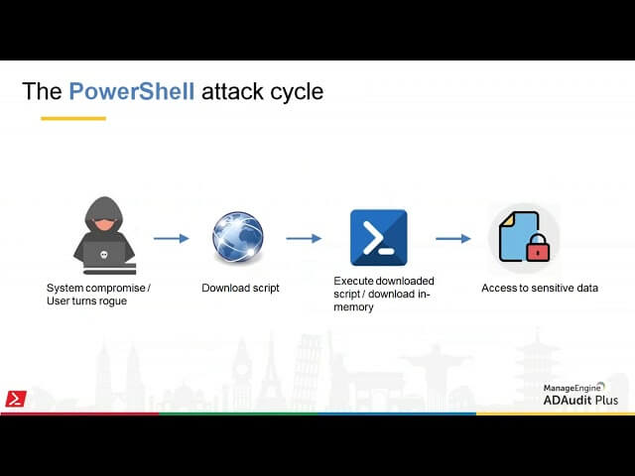
The problem we solved is classification of PowerShell scripts
The Dataset containing benign, malicious and mixed scripts – which are partly benign and partly malicious
We did not improve the dataset – but we did clean it.

Slide 3

Evaluation
Creation of new column with clean scripts
TF-IDF features are created using a trigram (3 ngram) approach with a vocabulary size of 10,000
Using SelectKBest to reduce the dimensionality of the feature space by selecting the top 1,000 most informative features
Features extracted from the ’cleaned script’ include: Text length, Function count, Numeric literal count, Has error handling, Has obfuscation indicators, Has suspicious words
Features extracted from the original script encompass: Entropy, Punctuation count, Longest string length, String literal count, Has URLs or IPs

Slide 4
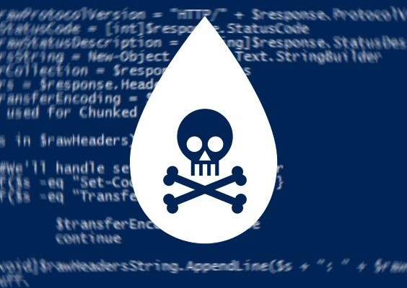
Data Exploration
identifying patterns
anomalous behavior
correlations
Notably, in the mixed model, we observed that 6,213 scripts contained suspicious words, suggesting their presence even within benign scripts.
Additionally, we detected outliers within the dataset. To mitigate their potential impact on model learning, we systematically removed them

Slide 5
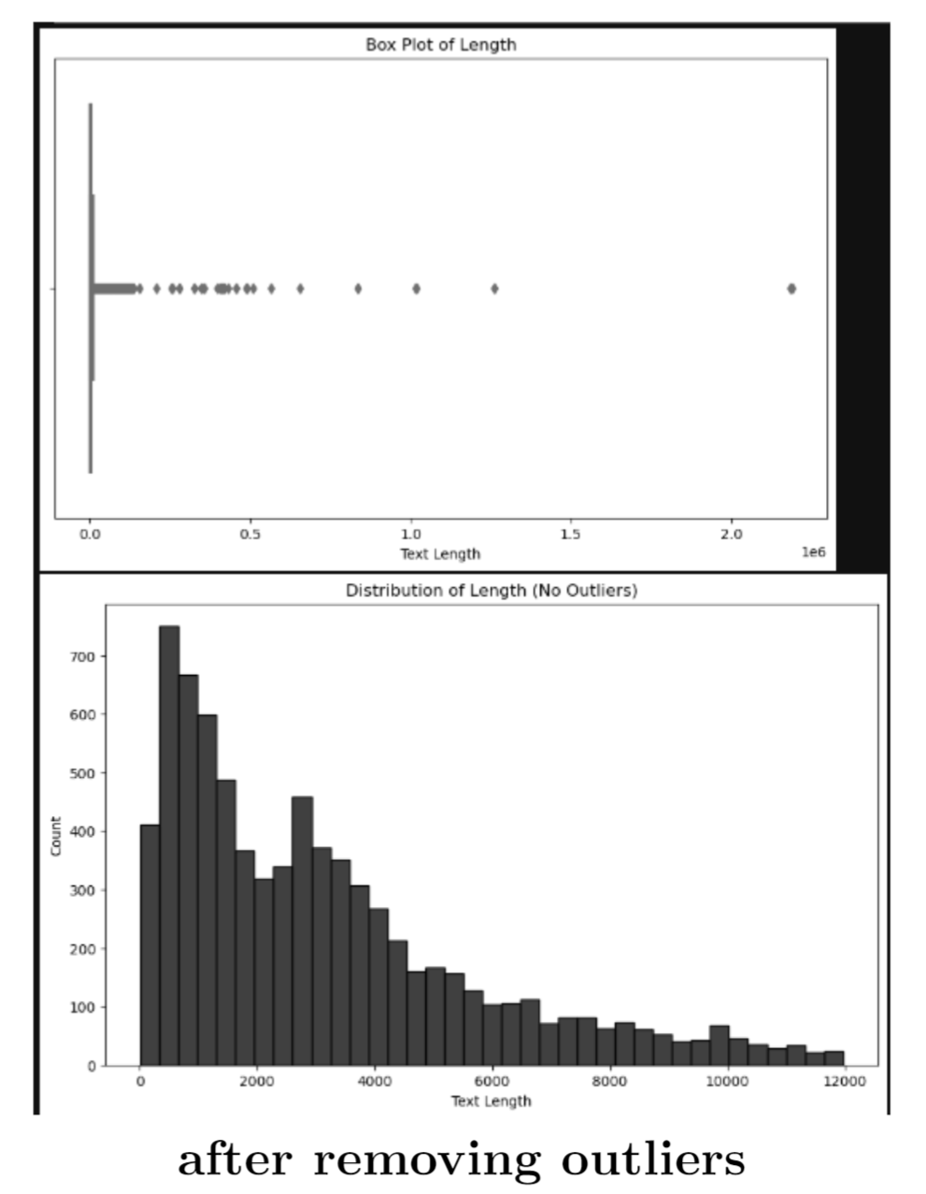
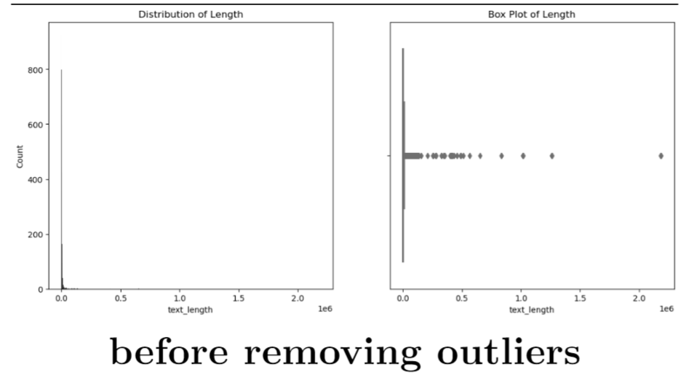

Slide 6
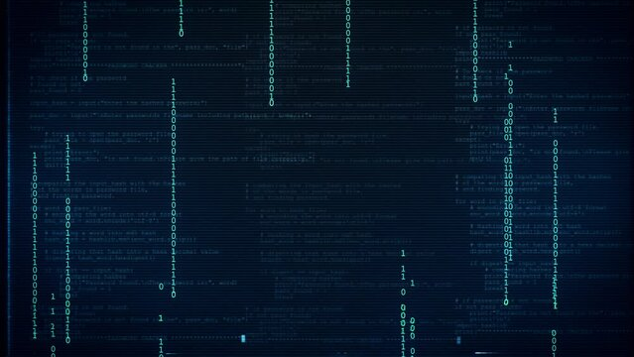
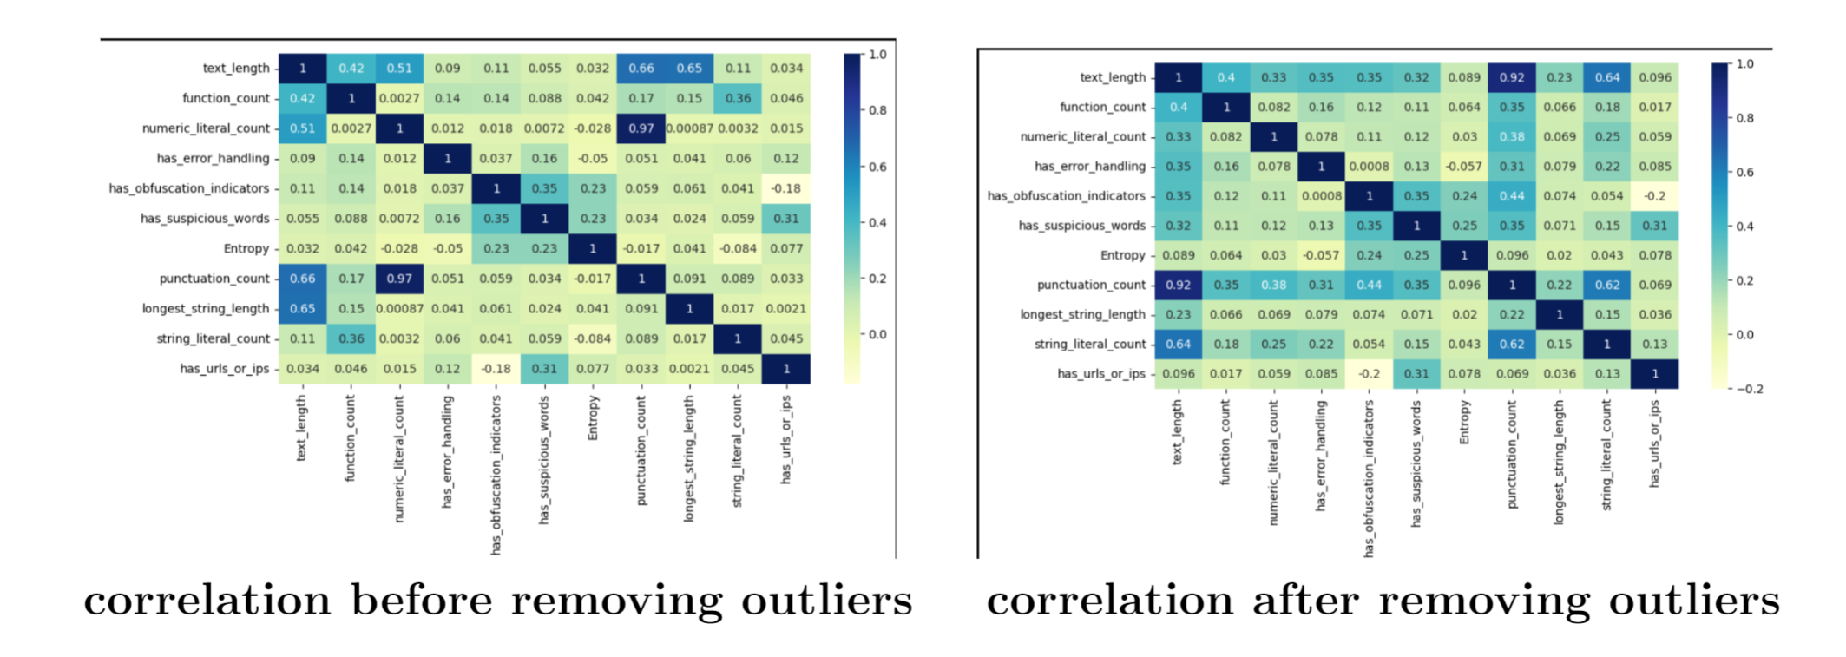
correlation

Slide 7
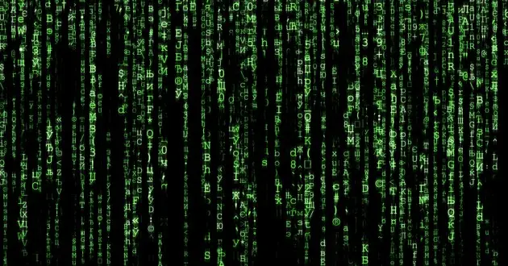
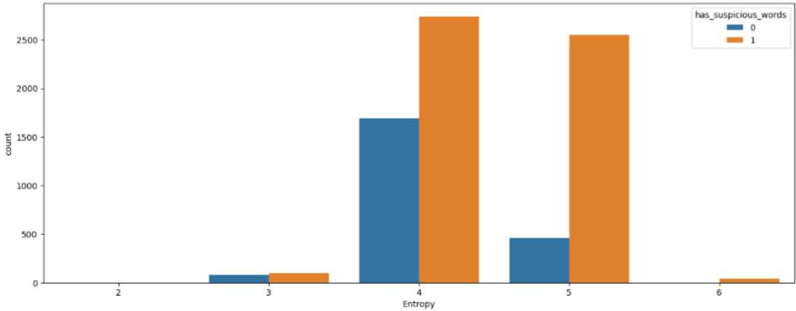
Suspicious-Entropy

Slide 8
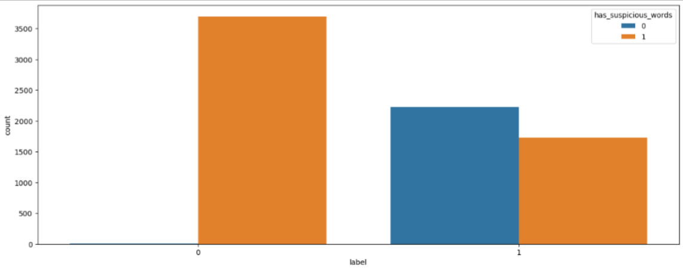
Suspicious-Label

Slide 9
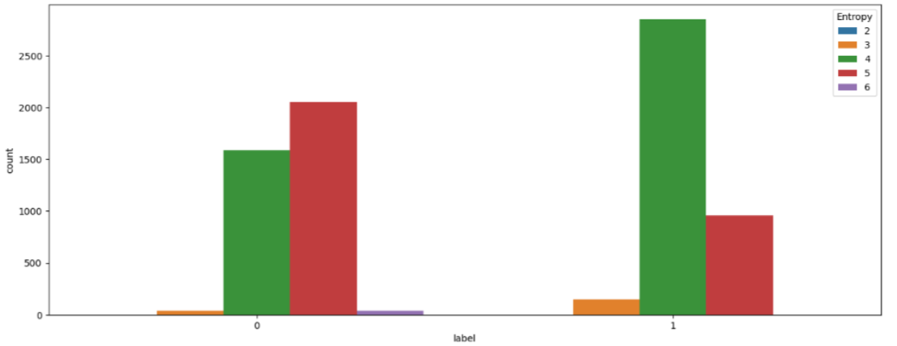
Label-Entropy

Slide 10
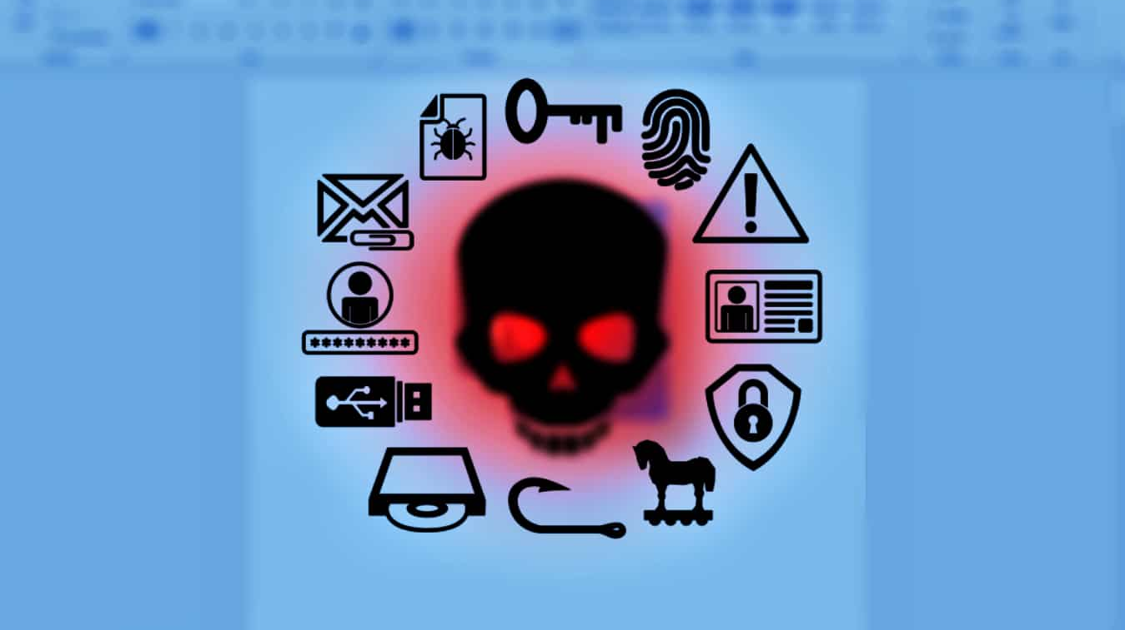
Training (Models)
XGBClassifier
RandomForestClassifier
Fivefold Cross-Validation

Slide 11
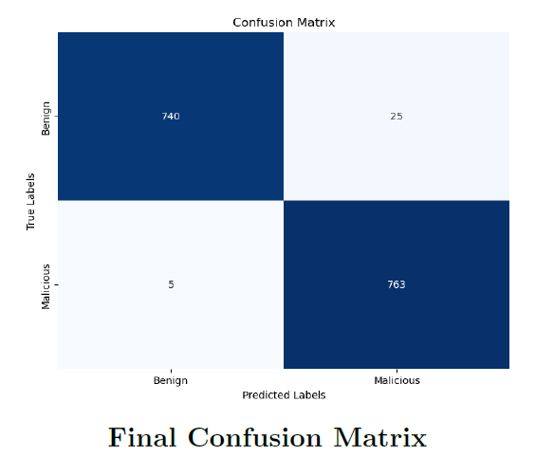
Confusion Matrix

Slide 12
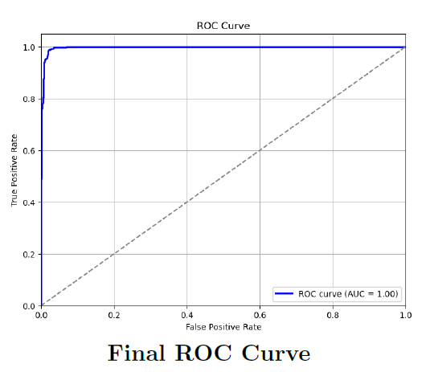
ROC Curve
The Receiver Operating Characteristic (ROC) curve was employed to illustrate the trade-off between true positive rate (sensitivity) and false positive rate (1 - specificity) across different threshold values.

Slide 13

Strongest Model -
five-fold cross-validation with the XGBoost (Extreme Gradient Boosting) model
- In our experiments,
the model achieved an accuracy of 98.66% in five-fold cross-validation, surpassing the paper’s reported accuracy of 97.76%.

Slide 14
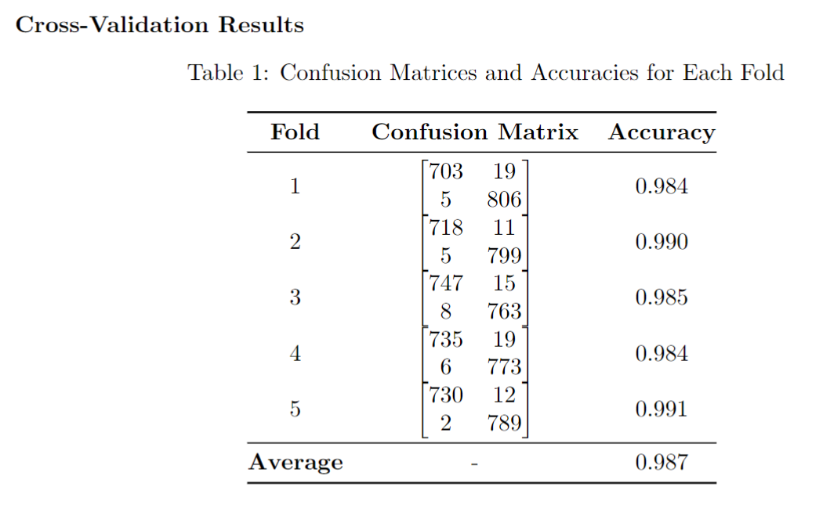
Strongest Model -

Slide 15
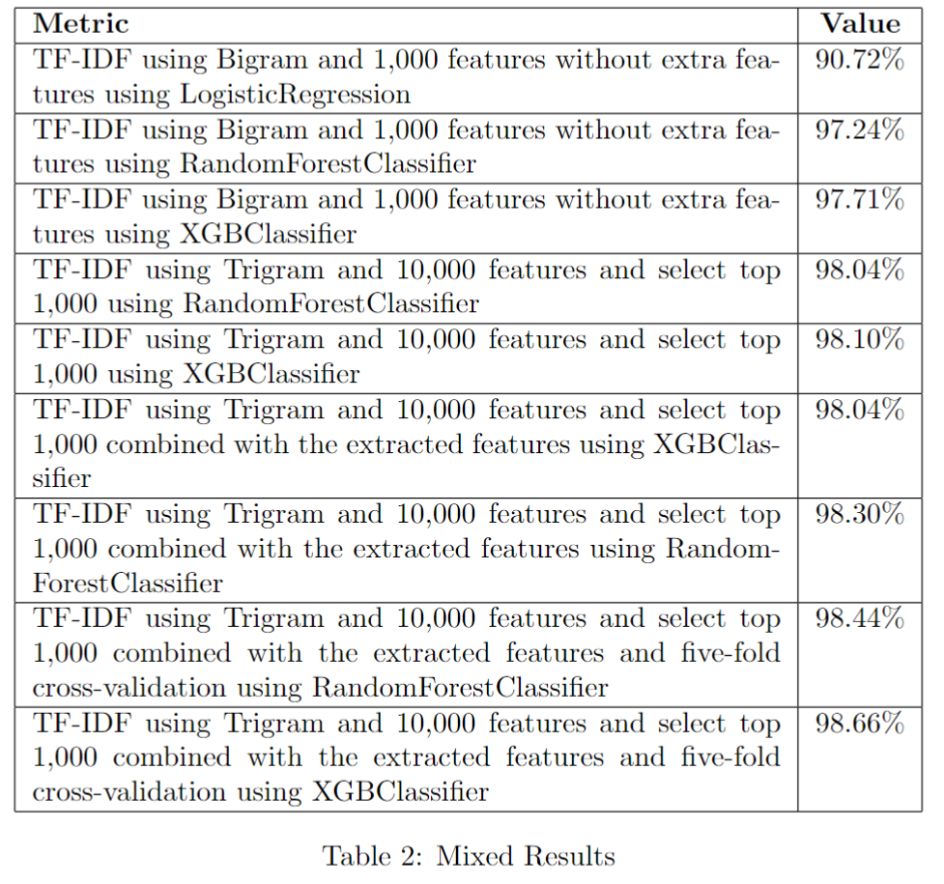
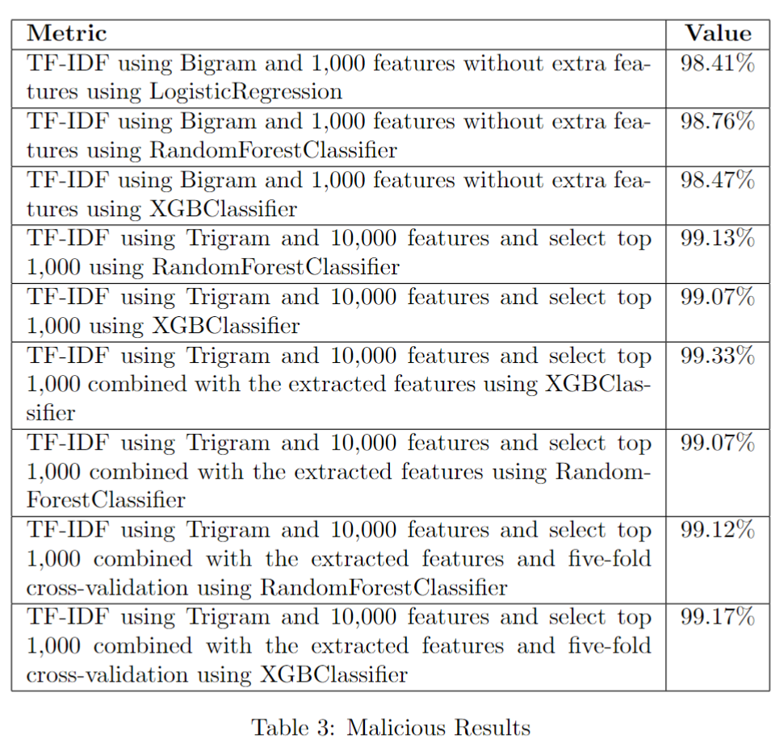
Reducing Mistakes Process

Slide 16
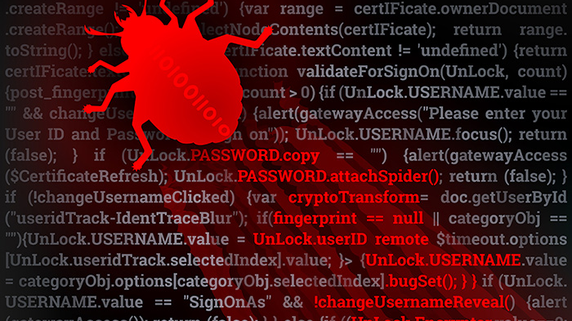
Demo

Slide 17

Future Work
De-obfuscate the obfuscated scripts – for better analyzing.
Create malicious scripts and remove duplicates.
Try to classify using neuro-networks and deep learning

Slide 18

References
Our github: https://github.com/TaliaSeada/UI_cyber/tree/master
https://doi.org/10.1016/j.neucom.2021.03.117
https://www.sciencedirect.com/science/article/pii/S0925231221005099
https://www.microsoft.com/en-us/security/blog/2019/09/03/deep-learning-rises-new-methods-for-detecting-malicious-powershell/
https://posts.specterops.io/learning-machine-learning-part-1-introduction-and-revoke-obfuscation-c73033184f0
https://github.com/GhostPack/Invoke-Evasion/tree/main
https://github.com/PowerShellMafia/PowerSploit

